Slide 1




Smart Chatbot System AI project By Python
Presented To : Ms. Lutfun Nahar
Assistant Professor, Department of CSE.
Presented by : Syeda Somiya Tasnim
ID: C191267

Slide 2

About Project
Project Name : Smart Chatbot System for University based on AI By Python
What is Chatbot:
Retrieval based Chatbot, A chatter robot (chatbot) is a type of conversational agent, a computer program designed to simulate an intelligent conversation with one or more human users in natural language via auditory or textual methods.

Slide 3
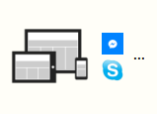

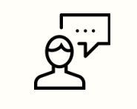


How AI Works in Chatbot?
User makes a request
Request analyzed
by artificial intelligence
User info taken into account
(history, preferences…)
Real time response
Conversational strategy
Interactions personalization

Slide 4
Why Python Based?
It makes use of a combination of ML algorithms to generate many different types of responses.
This feature allows developers to build chatbots using python that can converse with humans and deliver appropriate and relevant responses.
This makes Python especially useful for prototyping algorithms for AI.

Slide 5
Application of Project
Project is built using artificial algorithms that analyses user’s queries and understand user’s message.
This System is a web application which provides answer to the query of the Student, Teacher, Authorities.
Students/ Teacher/Authorities just have to query through the bot which is used for chating.
Can chat using any format there is no specific format the user has to follow.
The User can query any institution related activities through the system. The user does not have to personally go to the institution for enquiry.
The System analyses the question and than answers to the user.
The user can query institution related activities such as date and timing of annual day, sports day, and other cultural activities.
This system helps the student to be updated about the institution activities.
The System uses built in artificial intelligence to answer the query. The answers are appropriate what the user queries.

Slide 6
Flowchart
Start
User Input
Conversation/Query
Conversion
Query
Removing stop words
Reply with simple sentences that has been coded
Spell Check
Wordnet
Getting the suitable response
Yes
Matching with database
No
Notify Admin
Display Response
Give predicted purpose
End

Slide 7


Chatbot system Architecture
User
Response
Send
Feedback
To System
When answer is
Invalid
Login
Text
Enter Query
Admin
Response Selector
Query
Chatbot
Encode & Decode Data
Tokenization
WordNet
To Server
Responses
Feedback
System
Sentence Similarity Check
Database
Notes:
After you’ve done your research, it’s time to put your presentation together. The first step in the process is to introduce the topic. This is a great time to connect your topic to something that your audience can relate. In other words, why should they listen to all the information you will be sharing in your research presentation? What is in it for them? You may also want to include a graphic or image to grab their attention.
Feel free to duplicate this slide by right-clicking on this slide in the slides pane to the left and select Duplicate Slide.
The next step in your presentation is to state your claim or topic clearly. Your teacher may even call this your thesis. As you state your thesis, you may find that this layout is not the best layout for your claim or topic. You can change the layout by clicking the drop-down menu next to the Layout in the Slides menu section. You can choose Two Content, Comparison, or Picture with Caption. Note: A different layout might change the look of the icons on this page.
You will also want to state your facts. You have done the research now share some of the interesting facts with your audience. Facts do not have to be boring; you can communicate facts in a variety of ways by going to the Insert Tab. In the Insert tab you can:
Insert pictures from your computer or online.
Add a chart
Create some SmartArt
Insert a variety of icons to help your facts come to life. Note: You can change the color of the icons by selecting the icon and then click on the Format tab and then Graphics Fill. From there, you will choose a color from the list or choose More Fill Colors to give you more options.
Since this research presentation is a result of your hard work and searching, you want to make sure you support the claims or points in your presentation with facts from your research findings. Make sure you give the author proper credit for helping you share your ideas. If one of your sources has a video that is relevant to your topic, you can add the video as added support. Keep in mind the length of the video and the amount of time you have for your presentation. For a 5 minute speech, the video should be no longer than 30 seconds.
Questions to consider:
How will you state the author of the source?
Will you need to cite the source on the slide?
What are some ways you can engage your audience so they feel like they are a part of the presentation? Some ideas to consider is by taking a quick poll like: by a show of hands, how many of you think school uniforms are a way to cut down on bullying? Another suggestion is to have them hold up a certain number of fingers to see if they agree or disagree. Finally, you can share a story that the audience can relate to that makes them laugh.
After all the applause, your audience may have some questions. Be prepared to answer some of their questions by making a list of questions you think they might ask. You may also want to share the presentation with them by providing the link to your presentation, if they want more information.

Slide 8
Basic Chat App Representation

Slide 9
Flowchart for Admin Module
Admin
Login
Adding Query
View Dataset
Delete/Modify Query
Change Password
Admin Can login by using user name and password
Add Data to database by providing Question, Answer & catagory
Can view Dataset
According to catagory
Add, Delete, Modify Dataset from Database
Admin can change password by entering old and new password

Slide 10
Proposed Project Representation

Slide 11

Advantages

Slide 12
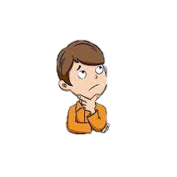
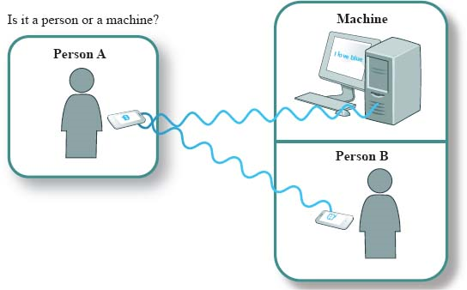
Did the project pass the Turing test?

Slide 13
User May Face
Upcoming Features
This system requires Internet Connection.
If many user enquires at same time, response will be slow.
A voice-activated chatbot
Differerant Language Translator
Appointment scheduling

Slide 14
Conclusion
In this project we made a institution specific chatbot system that
can be custom fitted to education domain chatbot, The addition
of this chatbot system in the institution website will make the
webpage more user interactive as it responds to the user
queries very accurately as it is a domain specific chatbot
System.

Slide 15



Thank You!
Notes:
You can use this slide as your opening or closing slide. Should you choose to use it as a closing, make sure you review the main points of your presentation. One creative way to do that is by adding animations to the various graphics on a slide. This slide has 4 different graphics, and, when you view the slideshow, you will see that you can click to reveal the next graphic. Similarly, as you review the main topics in your presentation, you may want each point to show up when you are addressing that topic.
Add animation to images and graphics:
Select your image or graphic.
Click on the Animations tab.
Choose from the options. The animation for this slide is “Split”. The drop-down menu in the Animation section gives even more animations you can use.
If you have multiple graphics or images, you will see a number appear next to it that notes the order of the animations.
Note: You will want to choose the animations carefully. You do not want to make your audience dizzy from your presentation.

